Slide 1

Automation Testing
By- Manas

Slide 2

ELEMENT LOCATORS
Locators are nothing but the identifications of the elements in application. Since every product in the world is having some identifications, in the same way every element in the application also having some identifications. These identifications we called as “locators” or “Attributes”

Slide 3

List of Locators:
1. ID
2. Name
3. Class
4. Tagname
5. Xpath
6. Link text
7. CSS(Cascade style sheets)

Slide 4
HOW WEBDRIVER IDENTIFY ELEMENTS
WebDriver will identify the elements in application based on the locators by using “findElement” method.
Syntax:
driver. FindElement (By. Locator(“value”));
Note:
We always prefer unique locators to identify the elements

Slide 5
Business Operation Commands in WebDriver
sendKeys(): To enter the value in a text box and to select the value in a list box.
Syntax:
driver. FindElement (By. Locator(“value”)). sendkeys(“Value”);
Note:
Before working on any element, we need to identify the element by using findElement method

Slide 6
clear (): To remove/clear value in a text box.
Syntax:
driver. FindElement (By. Locator(“value”)). clear ();
click (): To click on button/link and to check/uncheck checkbox and radio button in application
Syntax:
driver. FindElement (By. Locator(“value”)). click ();

Slide 7
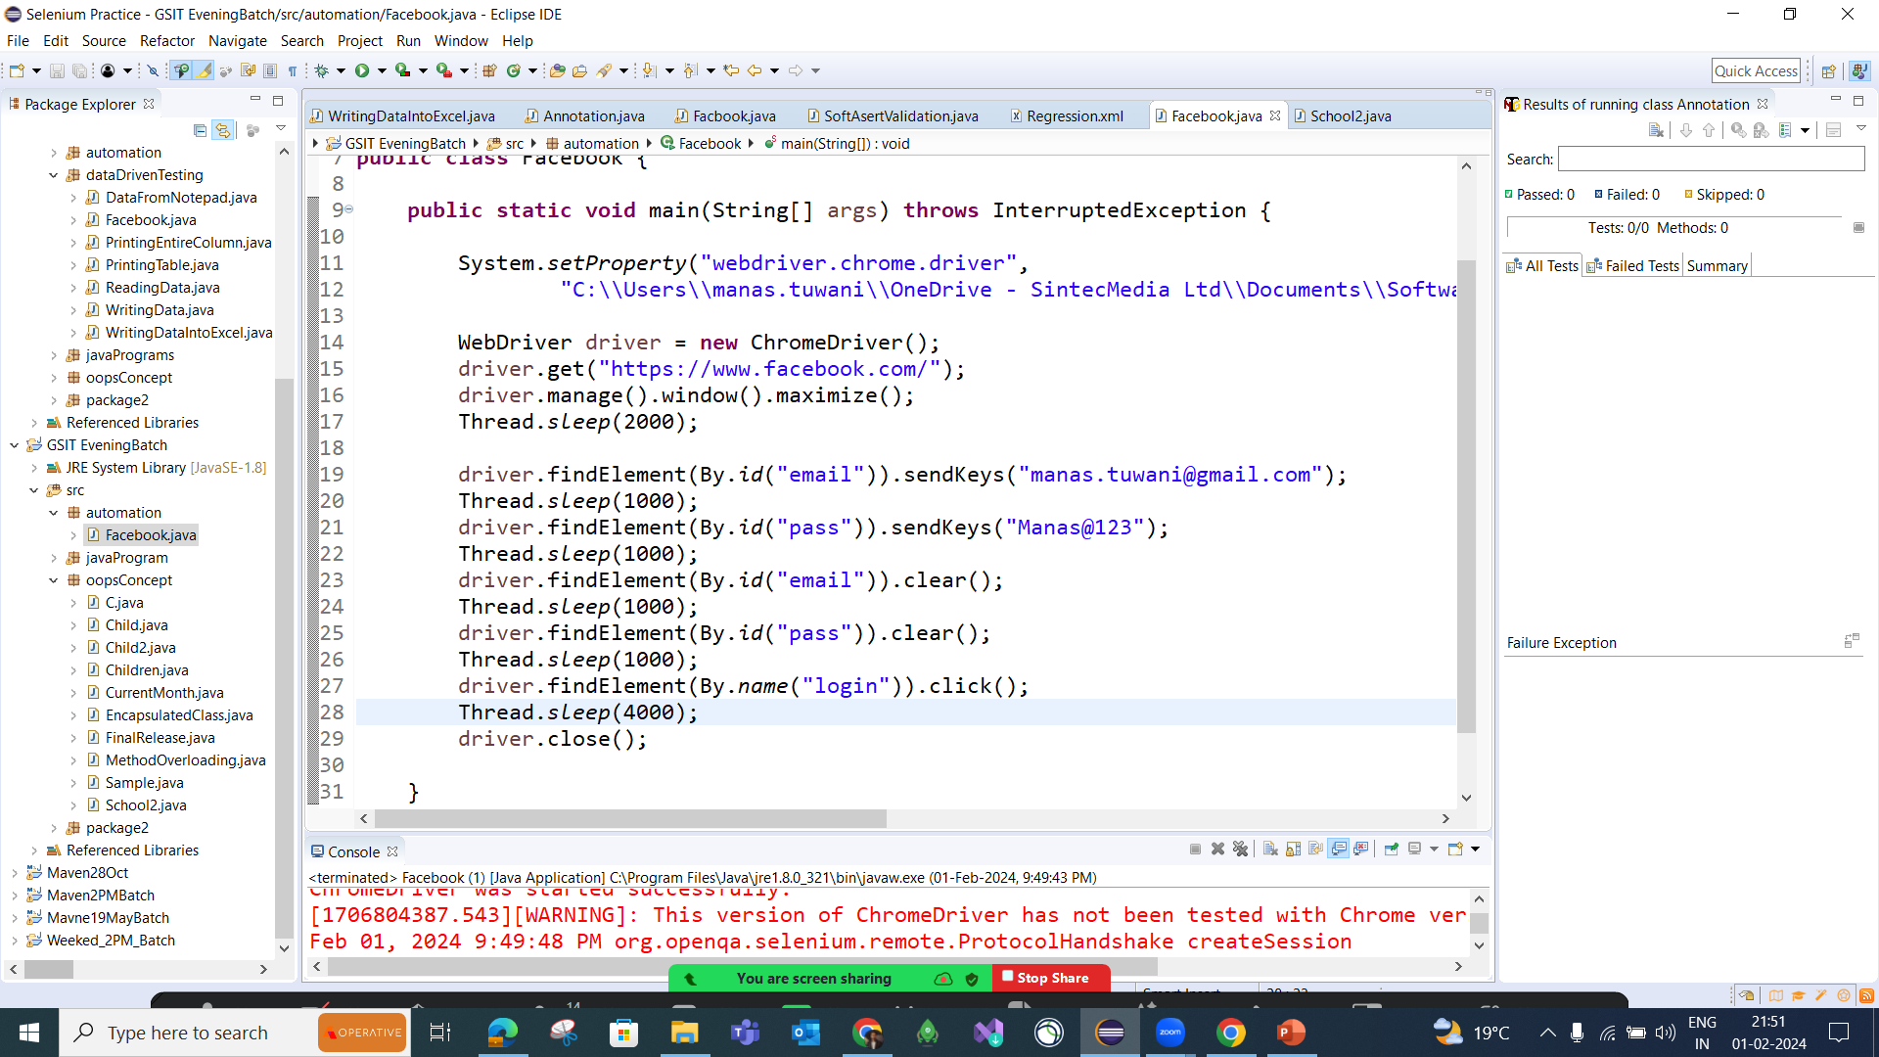
Prepare Test Script to launch Facebook application, Enter Email, Password, and clear Email Add and Password and click on the login button

Slide 8
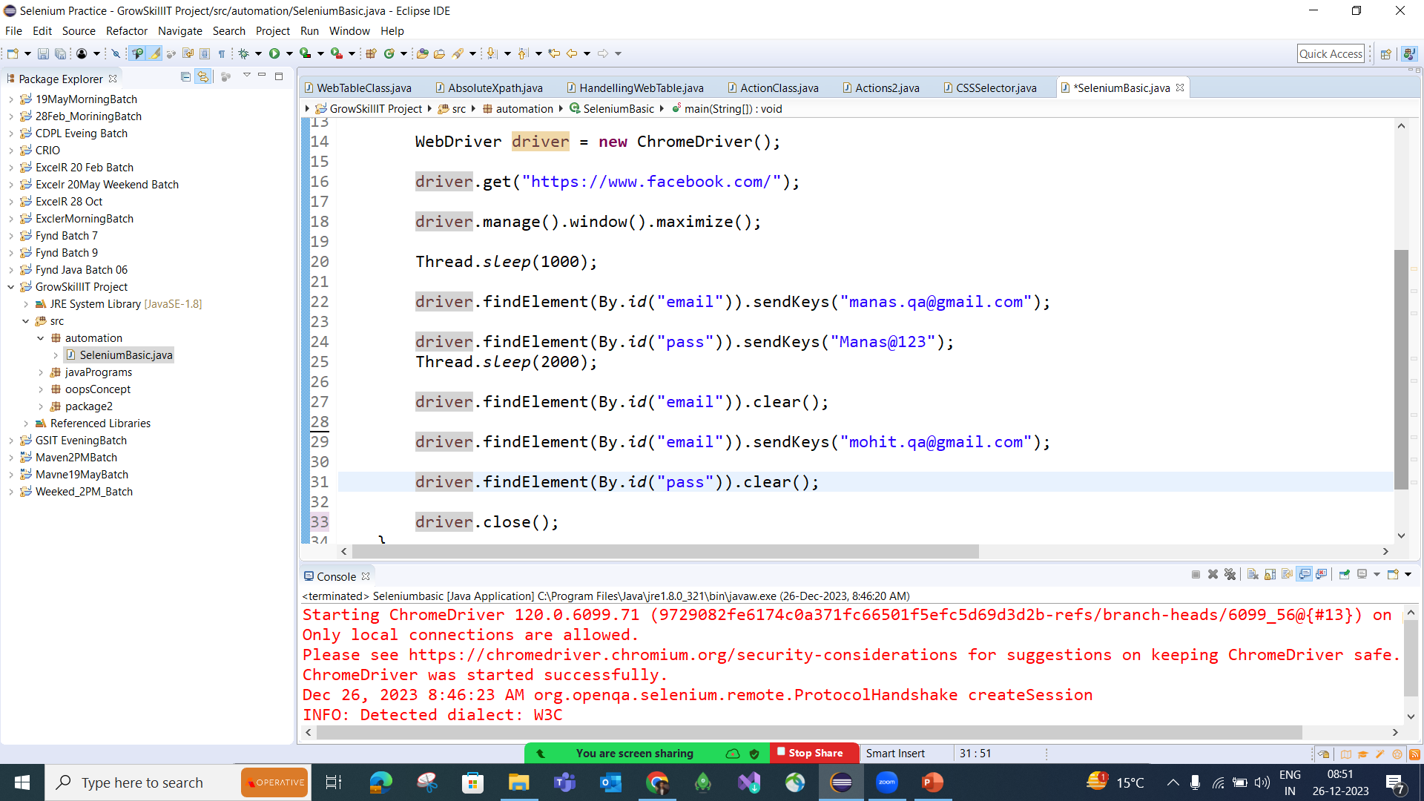

Slide 9
FAQ’s
How will WebDriver identify Elements?
WebDriver identifies elements using locators with methods like findElement() and findElements()
2. Which command using for enter value in textbox
sendKeys()
3. How to check/uncheck checkbox using WebDriver
Click()
4. What is the line Of code using for click on links
Click()
5. How to close application using WebDriver
Close()
6. What are diff types locators are available in selenium

